Slide 1
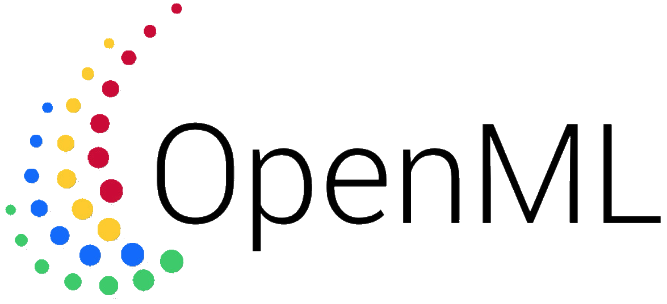
Deep Learning extension made by OpenML Support Squad
A.Danila, B.Enache, G.Goncheva, L.A.Hijl, A.Mares, V.Minev, T.Nguyen, A.L.L.Nijhuis, C.T. Nohai, D.M.Serban, T.Zahariev, S.Zarkova

Slide 2




Overview
OpenML
DL Extension Library
Visualization
Documentation
Progress
Demo
Notes:
Structure of the presentation.
The following aspects will be discussed in the same order as in this slide.
OpenML brief introduction and description
The extension to be developed - Extension DL Library - for the following libraries listed in order of priority.
Current progress; what we have achieved so far
A short demo, presenting the progress.

Slide 3




OpenML
Online machine learning platform for sharing & organizing
Data
Machine learning algorithms
Experiments
Core concepts
Datasets
Tasks
Flows
Runs
Notes:
OpenML is an online, open-source machine learning platform for sharing models built on different frameworks. For clarification, OpenML is not a platform which runs and trains machine learning models,it only deals with sharing and comparing them. This includes supporting the following aspects:
uploading / downloading / referencing datasets; analyzing the data, checking for problems and visualizing it.
algorithms can be uploaded through the website, or APIs. Code hosted elsewhere (e.g., GitHub) can be referenced by URL. Every flow gets a dedicated page with all known information, including a wiki, hyperparameters, evaluations on all tasks, and user discussions.
automates and facilitates experimentation and model building
OpenML operates on a number of core concepts which are important to understand:
The datasets simply consist of a number of rows, also called instances, usually in tabular form. They are automatically analyzed, annotated, and organized online.
Tasks describe what to do with the data from the dataset. OpenML supports 8 different tasks; two of them are Supervised classification and regression, which are the main focus of this project.
Flows are algorithms, workflows or scripts solving tasks. Usually a flow is specific to a task-type, i.e. you can not run a classification model on a clustering task.
Runs are applications of flows to a specific task. Basically it is is a particular algorithm, with a particular parameter setting, applied to a particular task.

Slide 4
DL Extension Library
Extension of the OpenML Python API
Currently supports only Sklearn
Provides support for DL libraries
Widely used deep learning libraries
Keras, Pytorch, Caffe2, MXNet, fast.ai, CNTK
Neural Network transfer specifications:
ONNX, MLFlow
Classification and Regression
Notes:
The team needs to build a series of libraries to support the different deep learning libraries that are available.
These libraries are implementations of the “Extension” class in the python API, which currently only supports sklearn.
Sklearn does not have deep learning capabilities so neither does OpenML. However, DL models are important for scientists who want to do tasks like this.
This is why it is important to also include DL libraries.
There are many DL libraries like KR, PT, C2, etc.
Default format: “ONNX” not a model itself, but a standard representation of one. Mappings for model > ONNX exist for many of these.
We need to convert them to OpenML flows, a format which is supported by OpenML and on which some tasks can be done that OpenML supports.
Want to compare them as runs.
OpenML does not run the model, but only stores information about the runs. This is used to compare models on a task.
We need to support Classification and Regression tasks for DL.

Slide 5

Keras Extension
High Level neural networks API
First user story
Important to client
Main capabilities of the extension for Keras
Serialize (to flow)
Deserialize (from flow)
Run on fold
Notes:
Keras is a high-level neural network API. It is very modular and user friendly. Models are defined in Python which allows for easy extensibility and is compact and easy to debug. It is also a library that is used quite a lot to describe neural networks
This was part of our first user story during the first sprint.
This means that is was very important to the client and it was also something that was feasible for us to do as the first library since it has a relatively simple structure. A direct mapping for a library that is used this much is very useful.
In order to make this library work, we had to implement the “Extension” interface that already exists in OpenML. We had to implement all of the functions in the interface for it to be compatible.
Serialization and Deserialization were first which allows us to map the model to a flow. This had to be done without any changes to the model. So if we serialize and then deserialize a model, it should remain the same as it was before serialization.
We also had to implement run_model_on_fold. Run a model on a repeat, fold, sub-sample triplet of the task and return prediction information. Furthermore, it will measure run time measures in case multi-core behaviour allows this. Returns the data that is necessary to construct the openml run object. Necessary to create and upload runs.
Finally we also implemented the additional functions.

Slide 6

PyTorch Extension
Low-level tensor library
Tensors as building blocks
Highly encourages one to create their own layers manually
The layers can not be serialized safely
A subset of possible networks, namely Sequential containers, can be serialized
Fitting procedure is not standardized and it had to be implemented manually
Manually selecting loss criterion, optimizer and learning rate scheduler
Configuration is callback-based
Notes:
Pytorch is another library that supports deep learning models. It is a very low-level library, which allows for a lot of flexibility but is also hard to work with.
There are no real abstractions for what a model should consist of and thus serialization and deserialization etc can be very hard to implement in OpenML
We discussed this with the client in the hope that we would only have to implement sequential models in pytorch, which should be a bit easier but is still no walk in the park.
The client agreed and we worked on only implementing the extension for pytorch sequential models.
Still had some difficulties………………………
Also implements functions talked about before: Serialization, Deserialization, Run on fold, Additional functions

Slide 7

ONNX Extension
Open Neural Network eXchange format
Network Format Transfer Specification
Attempts to be the official way of transferring models between libraries
Compatibility breaks often
Maps the network as a graph to Protocol Buffers
Most of the Deep Learning libraries support exporting to ONNX
Importing is highly unstable, due to breaking changes between versions
Can not be used to run or train the neural network
Initially attempted to use Keras as a backend for running and training
MXNet seems to be the right choice for now
Notes:
ONNX stands for Open Neural Network eXchange format.
It is a specification and not a model in itself.
It is used as a format which allows for changing between libraries. These changes might lose some small functionality, but the main structure of the models should remain intact.
Because of its nature it allows for mapping between the models that are library specific to other libraries.
These mappings already exist. We could make a mapping from ONNX to flow and allow many libraries that we do not directly support to be uploaded via ONNX. This would make it a lot easier and broaden our coverage a lot.
It could be used as a default mapping for libraries that are not supported yet directly.
There could be some difficulty when running on a task as people would have to choose library that is used to run.
ONNX does not run directly so they should use other libraries. Can choose but is still important to know what is actually used in order to convert from/to onnx

Slide 8

Visualization
Built using Dash Python framework
A derivative of Plot.ly
Visualize networks and their performance
Learning curve of the neworks
Structure of the neural network
Evolution of the loss during training
Notes:
Building web visualizations of the models / performance is an additional requirement for the Extension DL Library.
Based on the client’s request, it should be preferably done in the python framework Dash.
Dash is an open-source library, which abstracts away all of the technologies and protocols that are required to build an interactive web-based application. Furthermore, Dash’s apps are rendered in the web browser.
The learning curve graph of models and the structure of the ONNX neural network are the aspects have been requested to be visualized.

Slide 9
Documentation
Documenting is an important part of this project:
URD, SRD, ADD, SUM, STD, UTP, ATP
Constant updating
Self-documenting code
In-line code documentation results in automatically generated HTML documentation pages
Helps developers who continue the project

Slide 10
Progress
Finished documentation:
URD
Finished implementation:
Keras
In progress:
SRD
ADD
Pytorch
ONNX
Notes:
Short summarization of what is done and what is in progress

Slide 11
Questions?

